Slide 1
ARTIFICIAL INTELLIGIENCE
ON SMART PARKING
Mugle Sruthi (15)
Shubham Raj (39

Slide 2
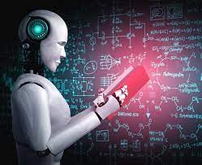
WHAT IS ARITIFICIAL INTELLIGENCE
Artificial Intelligence the simulation of human intelligence processes by machines, especially computer systems.
Specific applications of AI include expert
systems, natural language processing, speech
recognition and machine vision.

Slide 3
AI IN SMART PARKING
As we know in our day-to-day life there is a rapid increase &usage of AI .
So here how the AI works in Smart parking?
AI-based smart parking is an innovative parking solution that leverages data from different devices like sensors and cameras to form an AI-driven parking management system. These devices are either embedded into the parking lot or placed in close proximity to the parking lot to detect the availability of parking spots.

Slide 4

A video related AI in smart parking

Slide 5
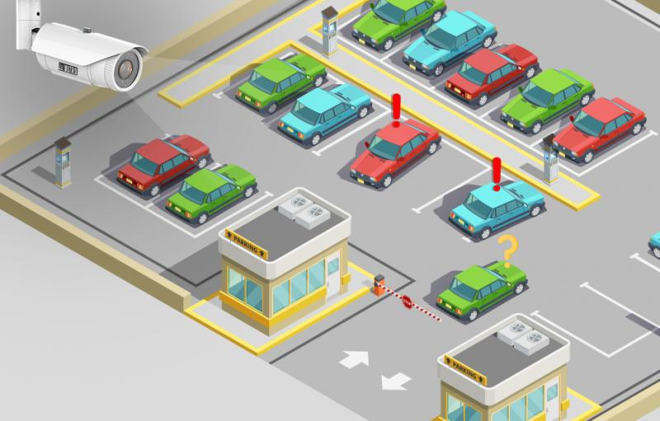
PARKING MANAGEMENT SYSTEM
What is Parking management System?
The system provides details of the vacant parking slots in the vicinity and reduces the traffic issues due to illegal parking in the vicinity. It is designed with an objective to meet the requirements of controlled parking that offers effortless parking tactics to the authorities.

Slide 6
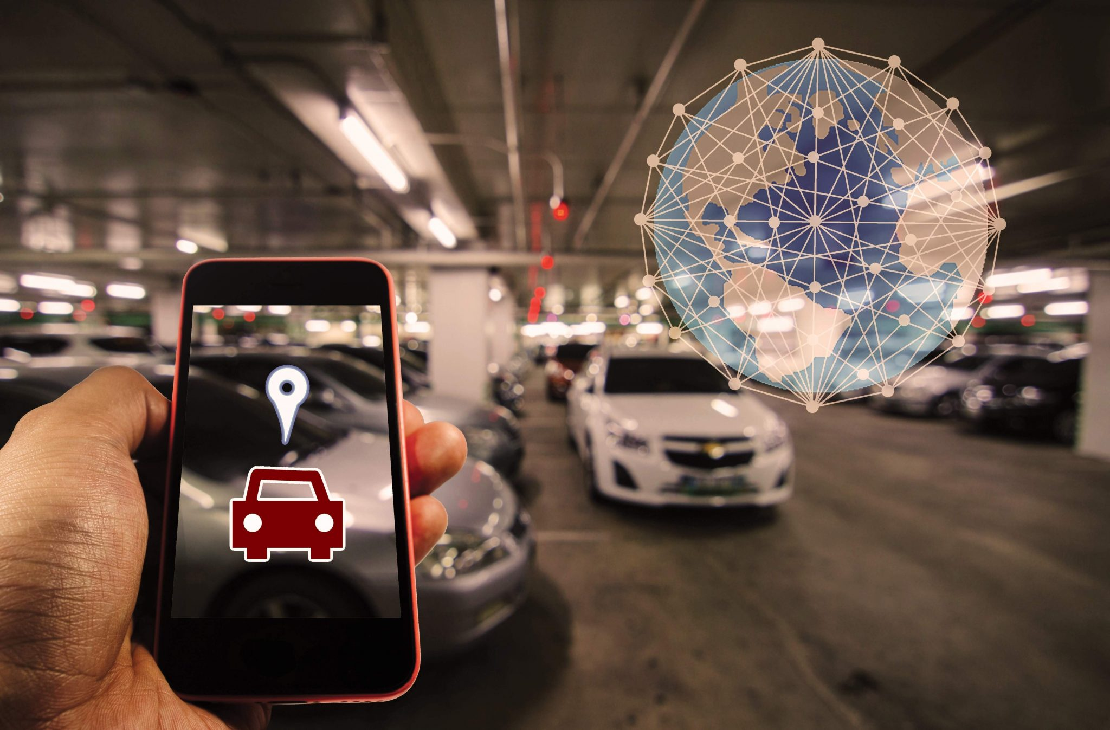
How AI can help you to optimize and manage your parking resources
How AI helps
AI enables machine learning which
Allows system to learn and accurately
Predict visitor demand Manage distribution
Of parking spots, As well as optimize traffic
Flow. This helps you to keep track of utiliza-
-tion as well as real time availability of park-
-ing spaces in order to ensure that your visitors
get Easy access and efficient utilization of your resources.

Slide 7
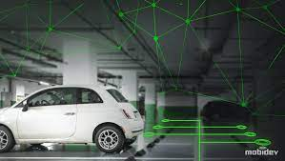
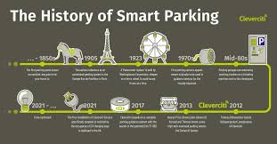
How to get started with AI in your Parking management system
Choose the right AI platform
Choose the right platform to get you started
With AI. Start by finding out which AI
Technology works best for your parking
Management.
Integrate AI into your System
Integrate the chosen AI technology into your
parking management system to enable AI
powered features and automatic vehicle
parking control. smart indoor navigation and
automatic vehicle recognition

Slide 8
AI Based smart parking Solution
Real Time Occupancy and Availability
Benefits for parking managers: That real-time information about parking occupancy and availability can be observed or analyzed later. Every parking manager, parking analyst or decision-maker can optimize the current parking management strategy at any time!
Benefits for parking users: We all know that there are too many vehicles and not enough parking spaces. Thanks to the real-time data about parking occupancy and availability, parking users can easily find where to park their vehicle. That eliminates one of the biggest parking problems – circling for an empty parking space and city traffic.

Slide 9
Methodology
The proposed AI Parking Management System will be developed using a combination of hardware and software components .
The hardware components will include sensors and cameras installed at parking locations to detect the presence of vehicles and collect data on parking usage .
The software components will include machine learning algorithms to analyse the data collected from sensors and cameras and predict parking

Slide 10
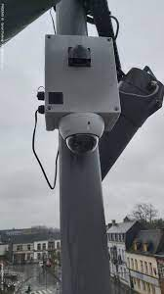
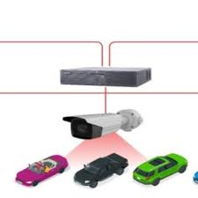
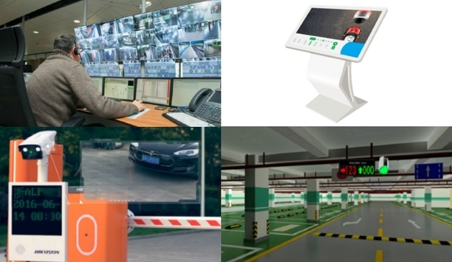
Images related smart parking

Slide 11

Code Output
Click picture

Slide 12
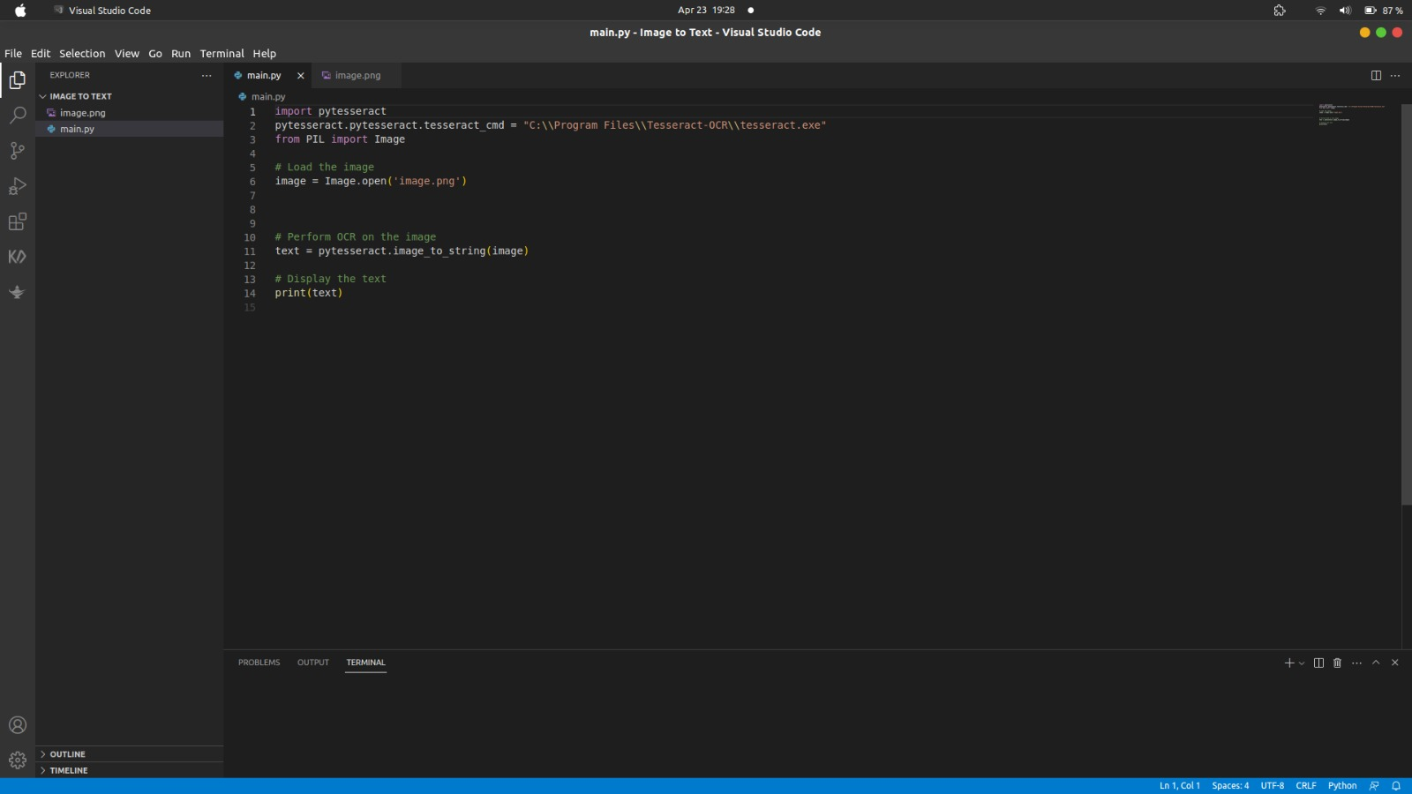
Image to text

Slide 13
Research papers
https://parkingtelecom.com/en/ai-based-smart-parking-solutions/
https://www.hindawi.com/
https://www.researchgate.net/publication/341870728_Smart_Parking_System_based_on_IOT

Slide 14
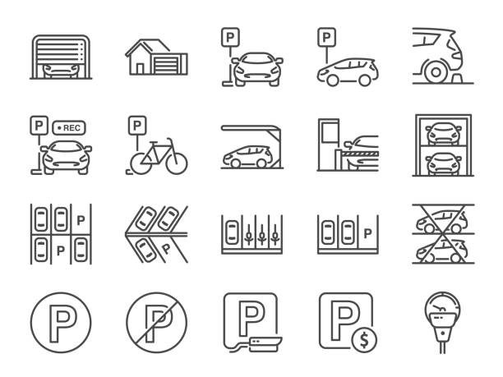
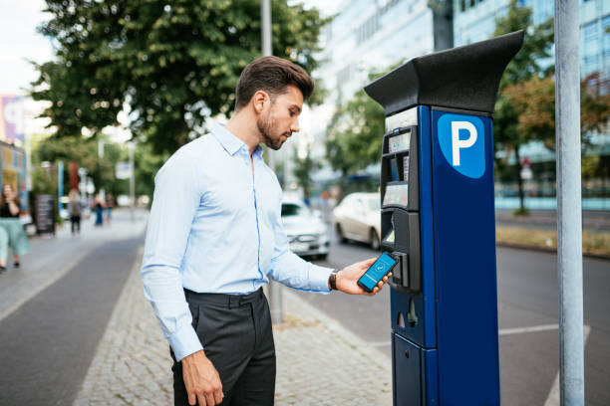
Images

Slide 15
THANK YOU

